Slide 1

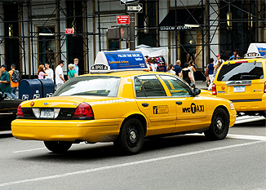

CAB BOOKING SYSTEM
Business Flow Diagrams
Group Members:
Mpho Makhari
Sonam Kumari
Nokuthula
Mentor: Ms Dipuo

Slide 2

Project Outline
Problem Statement
Solution
Inheritance
Association
Dependency
Full Class Diagram
Question Slide

Slide 3


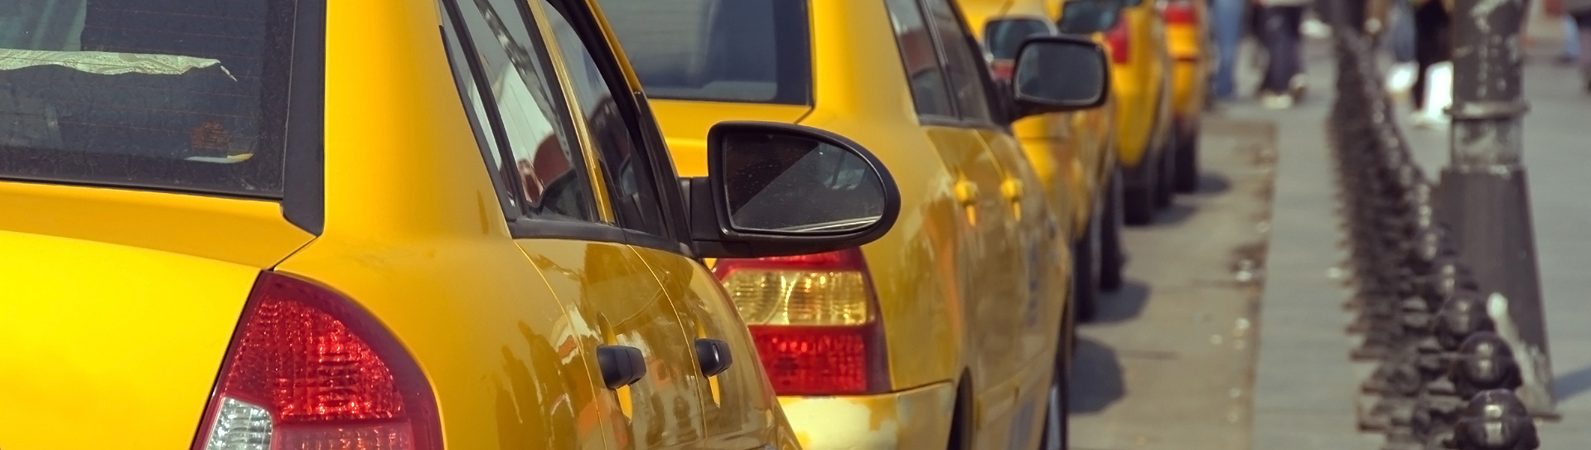
Problem Statement
CAB Booking Application
Create a class Diagram for cab booking app.
Identify entities and their state and behavior

Slide 4

Solution
CAB Booking System
Explored cab booking app details.
Identified real world objects.
Created entities for them.
Identified fields for each entity.
Identified methods for each entity.
Identified relationships between entities.
Created class Diagram in Ms Visio.

Slide 5
Inheritance
Inheritance is a parent-child relationship where we create a new class by using existing class code
User play one out of two roles: Client and Driver
User is a client
User is a driver
User (Super type)
Customer(Sub Type) IS-A User
Driver(Sub Type) IS-A User

Slide 6

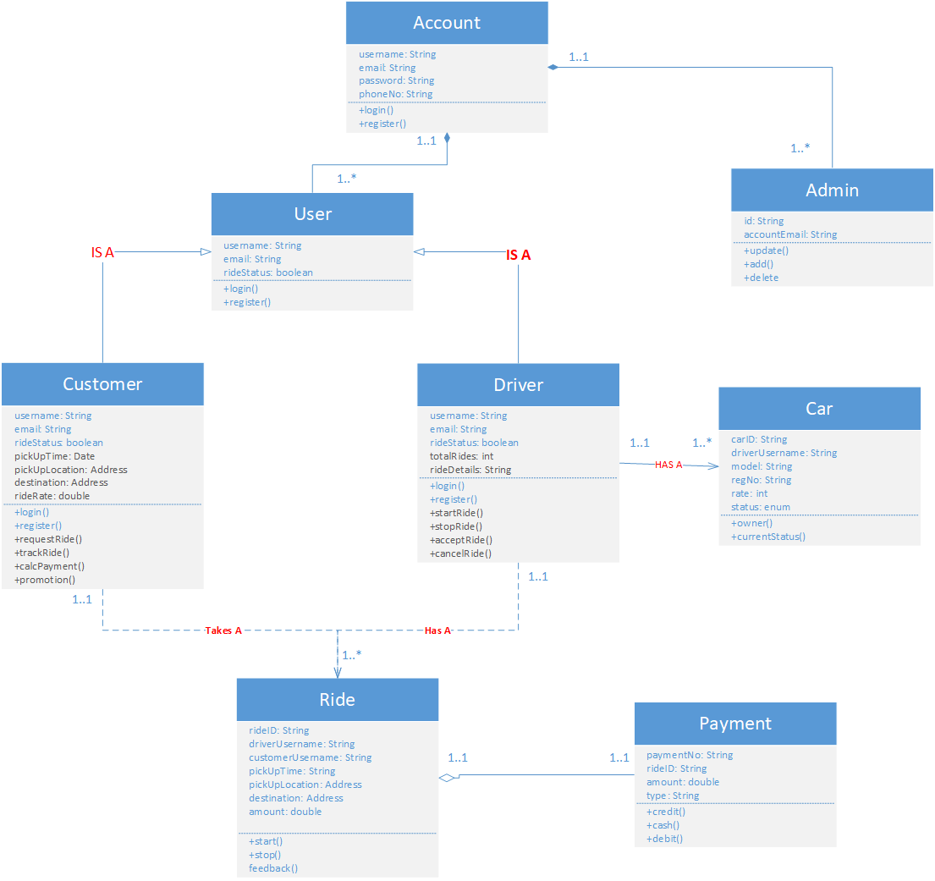

Association
Association is the relation between two separate classes which establishes through their Objects
One Driver has one or many Cars

Slide 7
Dependency
Customer takes a ride while Driver has a ride
Customer Entity
One Customer can add many Ride request
One Customer can take many Rides
Driver Entity
One Driver can receive many Ride request
Ride entity
One Ride is taken by one Customer
One trip has one driver

Slide 8
Full Class Diagram

Slide 9


Question Slide.

